Slide 1
research file Organization
The Life-Changing Magic of Tidying Up
Brooke Anderson and Rachel Severson

Slide 2
What we’ll talk about
Why should you organize your research files?
How should you organize your research files?
What can you do with well-organized files?
Advanced topics: What can you do with a standardized directory structure? What can you do with Git?

Slide 3
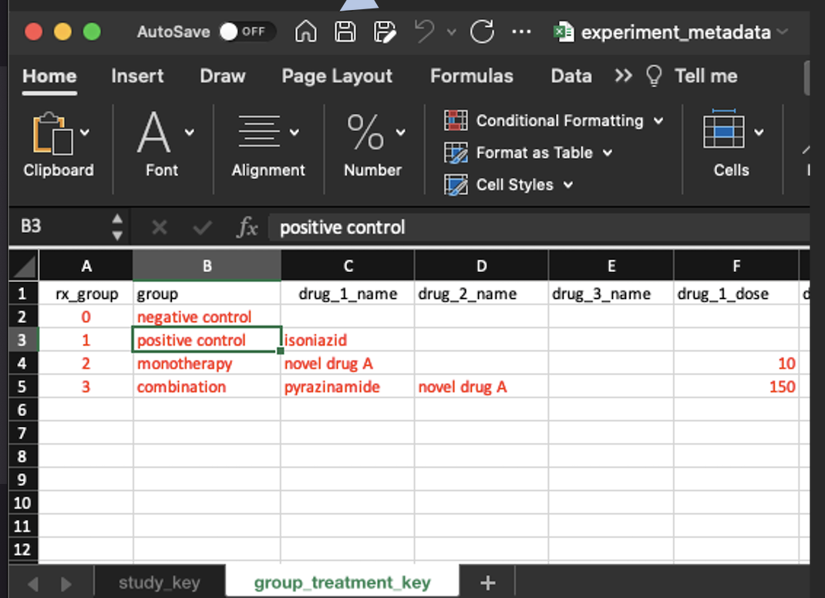
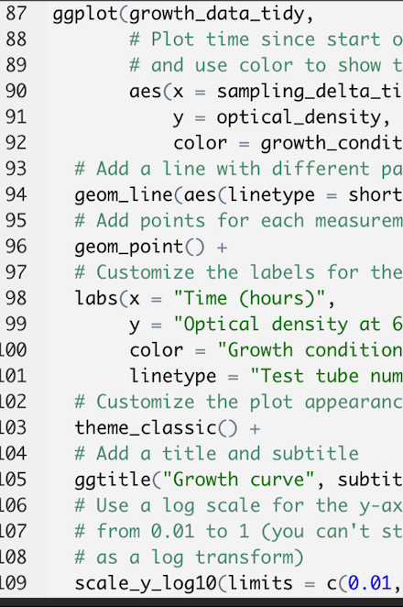
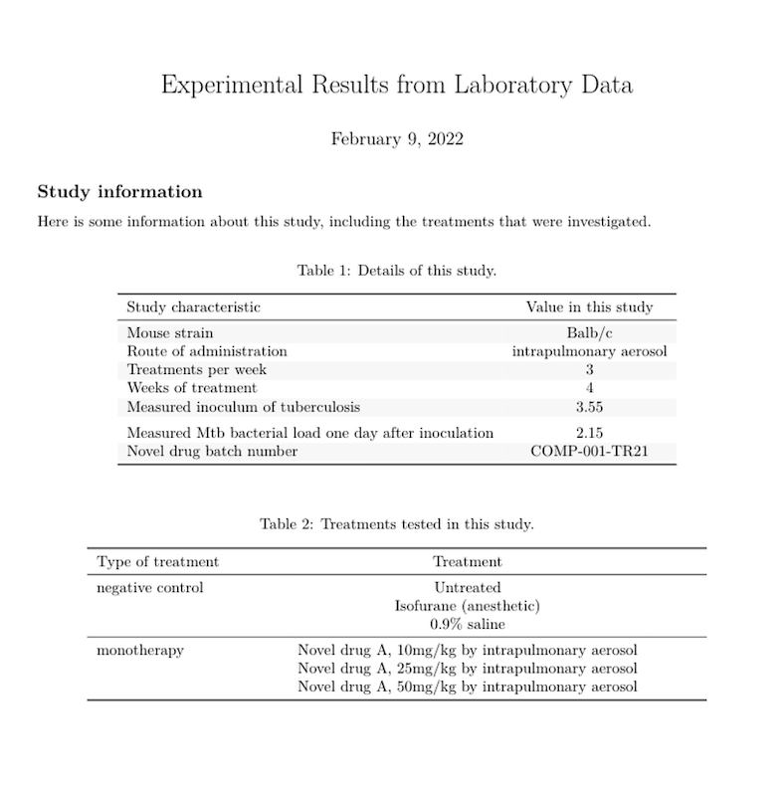
Research files
Research datasets
Code scripts for pre-processing and analyzing data
Reports and presentations

Slide 4
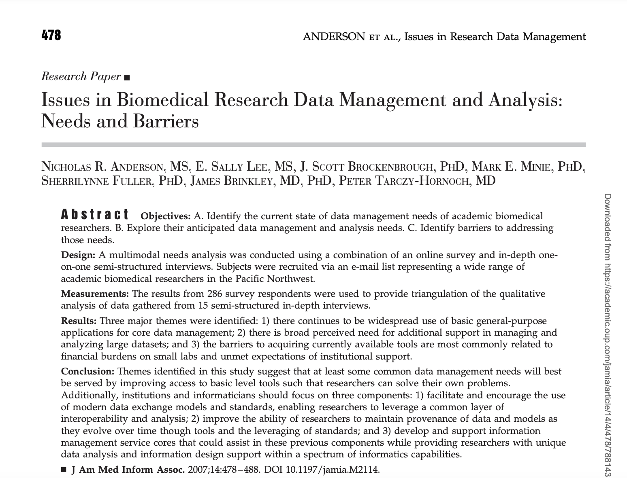
File organization in practice
One study surveyed over 250 biomedical researchers at the University of Washington.

Slide 5
File organization in practice
They noted that, “a common theme surrounding data management and analysis was that many researchers prefer to utility their own individual methods to organize data. … Some researchers admitted to having no organizational method at all, while others used whatever method best suited their individual needs.”

Slide 6
Respondent answers
One respondent answers, “They’re not organized in any way---they’re just thrown into files under different projects.”
Another respondent: “I grab them when I need them, they’re not organized in any decent way.”

Slide 7
Why organize files

Slide 8
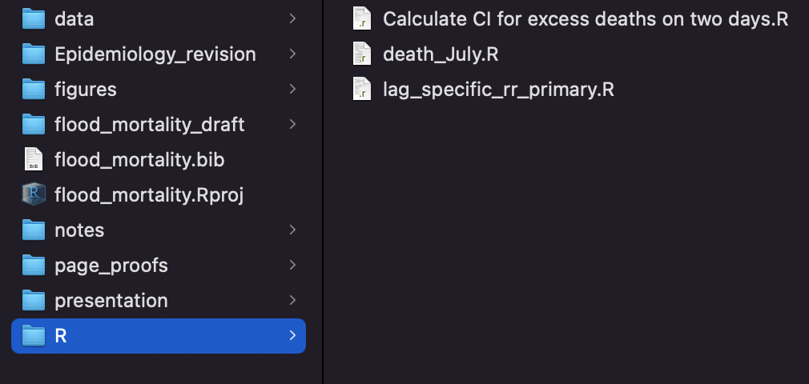
Efficiency
With good organization, “Methods and data sections in papers practically write themselves, with no time wasted in frenzied hunting for missing information.” –Baker, 2016
You can quickly get new people up to speed and efficiently pass along lab research projects as people come and go from the lab group
You can write tools that work with the structure

Slide 9

Efficiency
“Everything you do, you will probably have to do over again. … If you have organized and documented your work clearly, then repeating the experiment with the new data or the new parameterization will be much, much easier.” --Noble, 2009

Slide 10
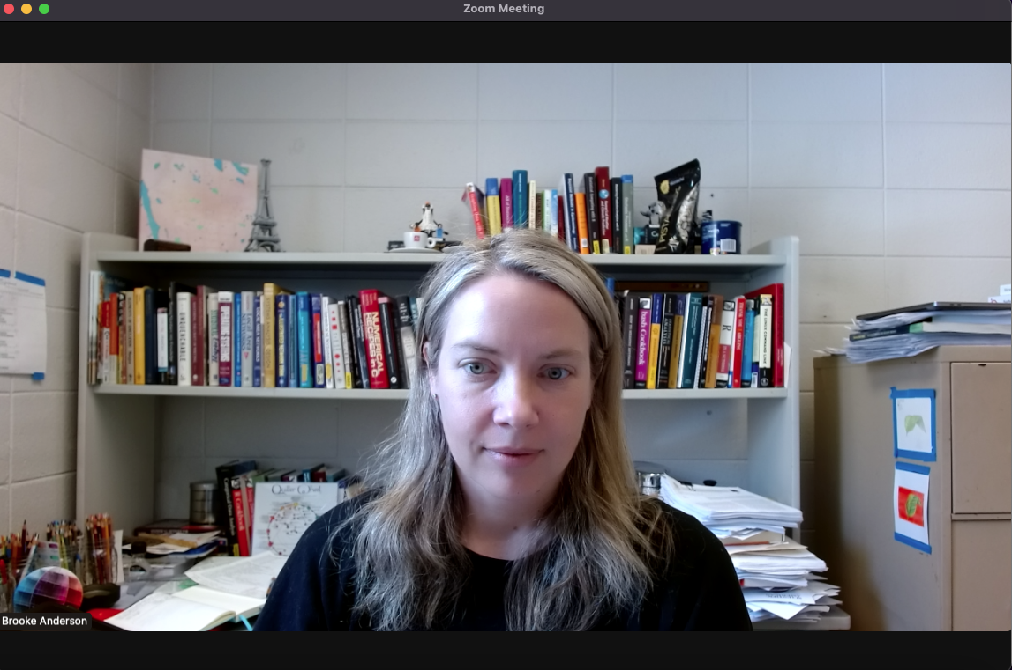
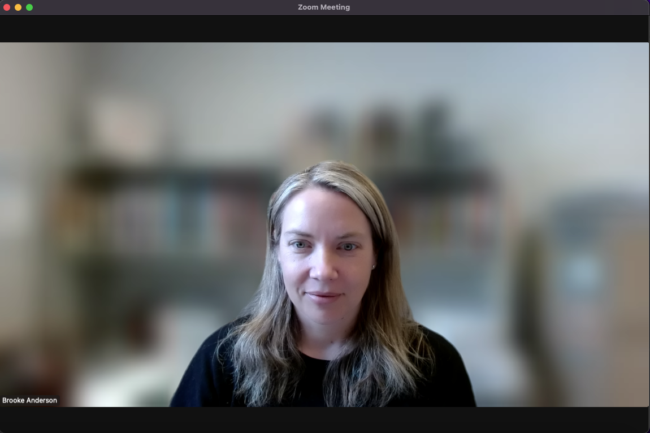
Sharing research files
We’re less likely to share things that aren’t tidy. This is why we often blur our backgrounds for online meetings!

Slide 11
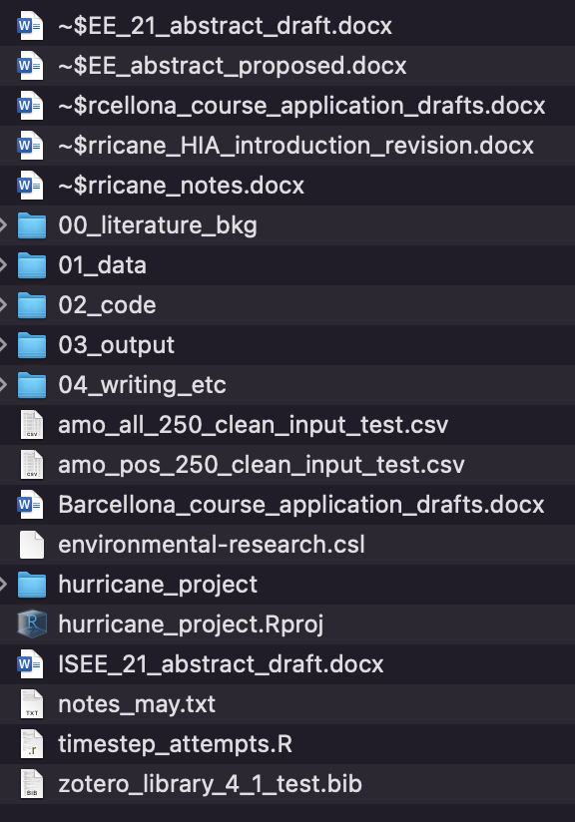
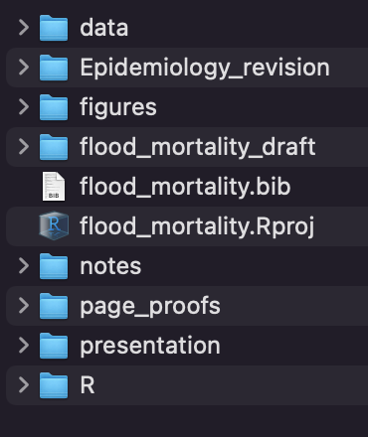
Sharing research files
“Without clear instructions, many researchers struggle to avoid chaos in their file structures, and so are understandably reluctant to expose their workflow for others to see. This may be one of the reasons that so many requests for details about methods, including requests for data and code, are turned down or go unanswered.”
–Marwick et al., 2018

Slide 12
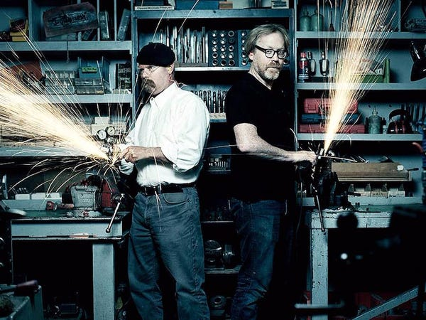
Adam Savage

Slide 13

Knolling
”I started to clean up before heading upstairs at the end of the day, and lo and behold the shop became a far more efficient and well-oiled machine to work in.
The freed-up space in my mind and the open work space at my fingertips allowed me a lot of room, both mental and physical, to pursue a wide variety of projects, and I finally started to understand how much benefit was to be gained by taking the time to clean.”

Slide 14
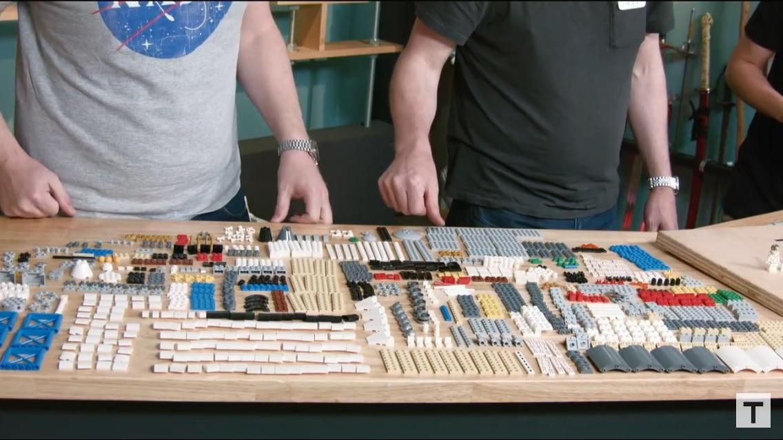
Knolling Legos

Slide 15
Why you should organize research files
You can do your research more efficiently
You can introduce new people to the project quickly
You are more likely to share well-organized files, which is critical for research reproducibility
You have more mental space to focus on substantive questions as you work

Slide 16
How to organize files

Slide 17
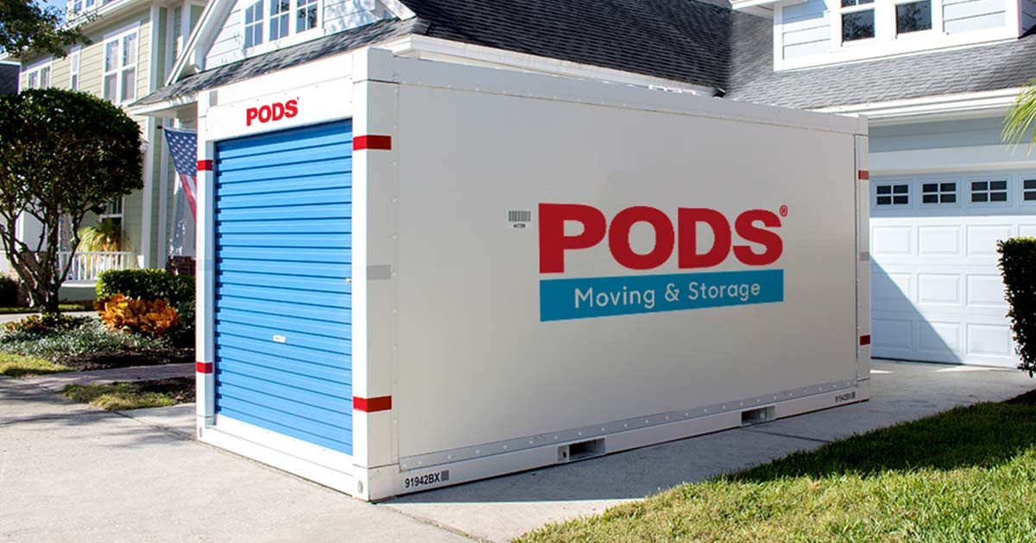
Using a single directory
Easy to set up as an R Project
Easy to set up with version control
Portable
Shareable

Slide 18
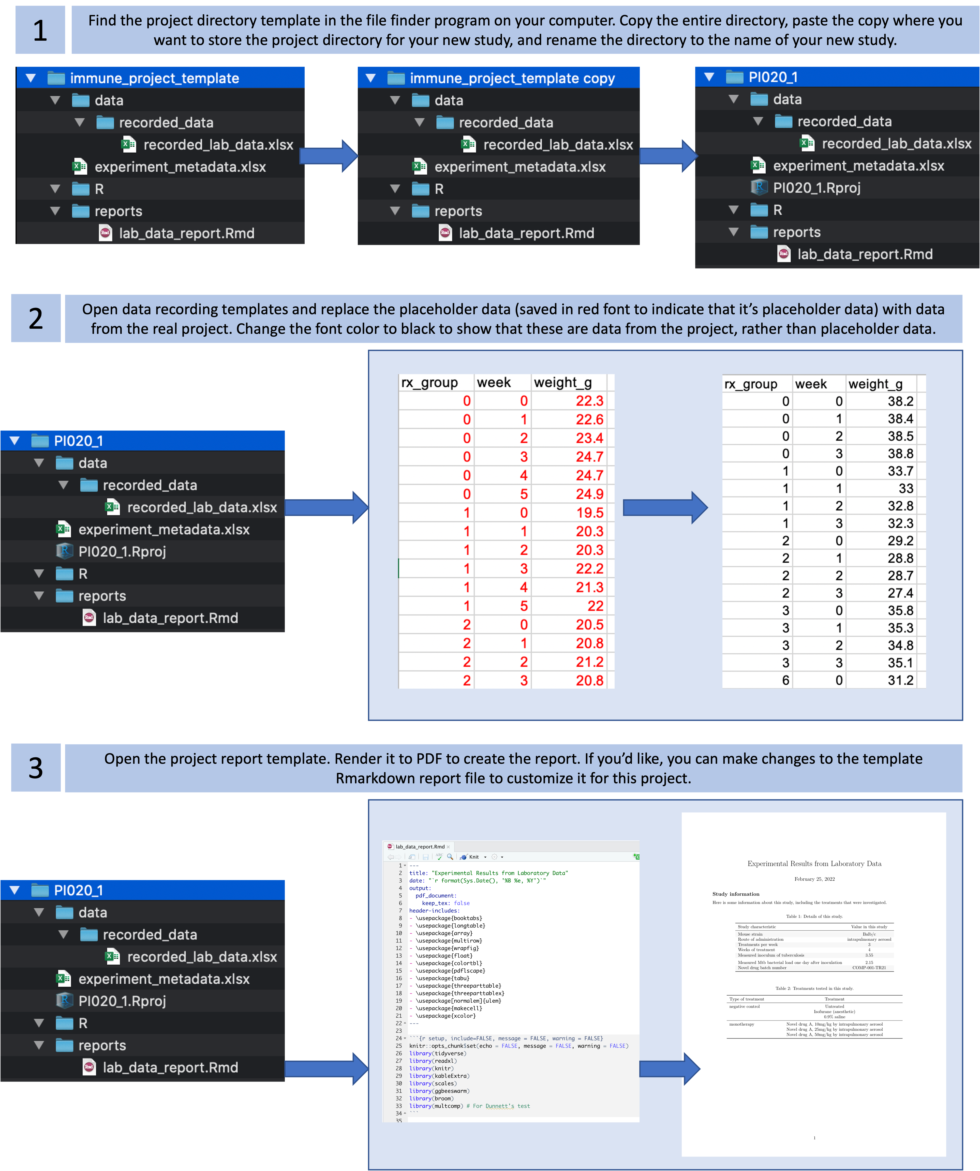
Blueprint versus physical template
The physical implementation of this is very simple—create an empty example directory and copy and rename for new projects. The harder part is designing a good structure for the directory.

Slide 19
Designing your system
Think about use
Think about reuse
Think about discoverability

Slide 20
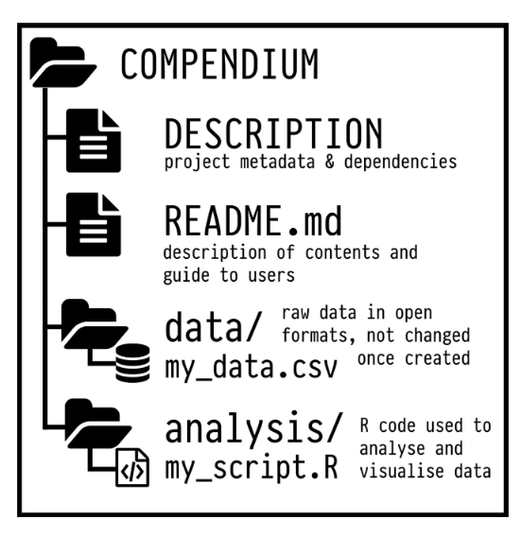
Use and Reuse
Group similar types of files together
Name subdirectories generically

Slide 21

Discoverability
Can a user figure out how to use something quickly, easily, and correctly?

Slide 22
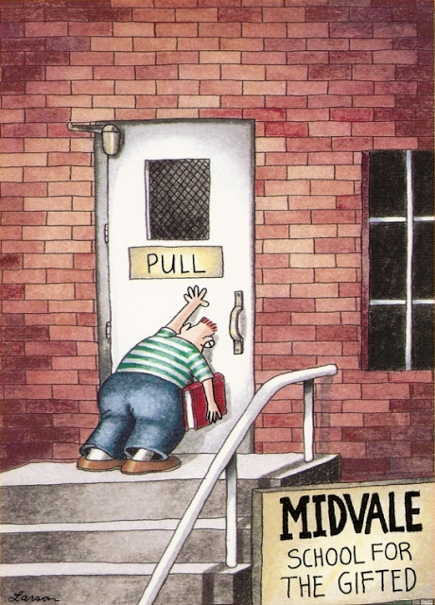
Discoverability
Can a user figure out how to use something quickly, easily, and correctly?

Slide 23
Discoverability
“The key principle is to organize the compendium so that another person can know what to expect from the plain meaning of the file and directory names.” –Marwick et al., 2018
“The core guiding principle is simple: Someone unfamiliar with your project should be able to look at your computer files and understand in detail what you did and why.” –Noble, 2009

Slide 24
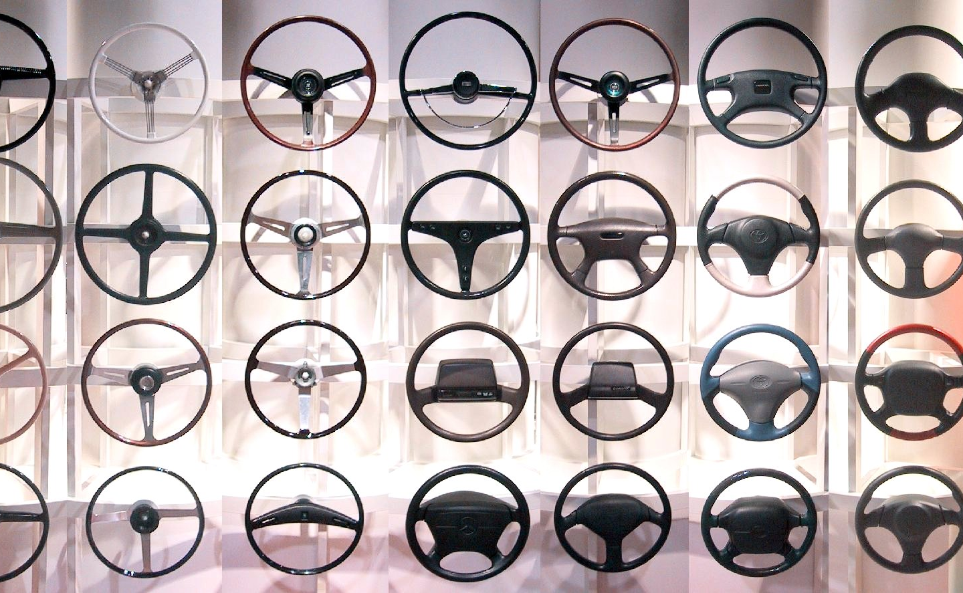

Standards aid discoverability
If you follow a standard of your broader academic community, it makes project files easy for someone else from that community to navigate (Marwick et al., 2018).

Slide 25
Use a standard system to organize files
Community-level standard
Research lab standard
Individual standard

Slide 26
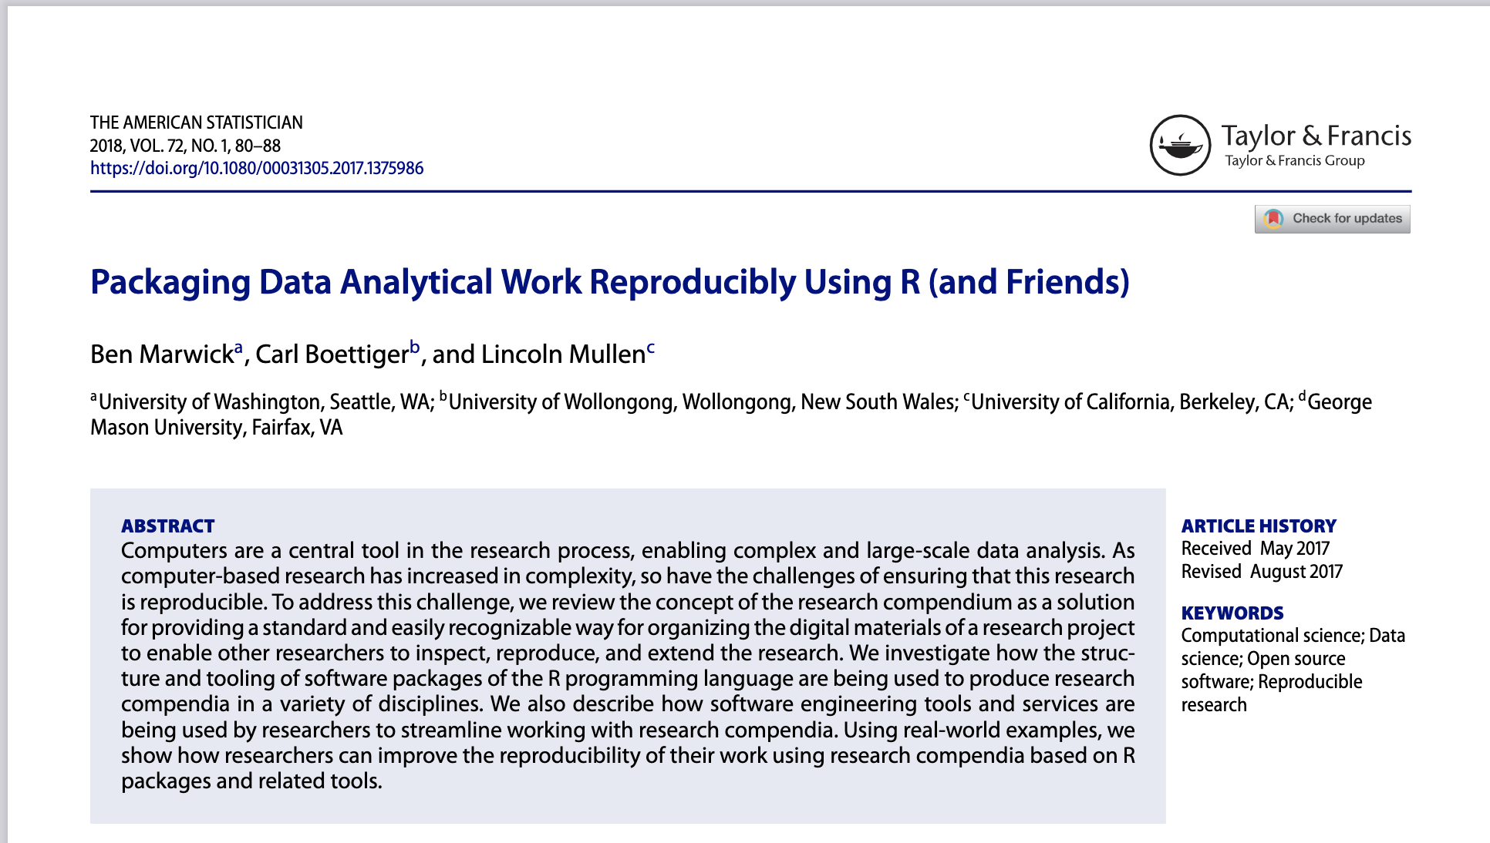
Marwick—Compendium based on R Package structure
Marwick et al. suggest a series of directory structures in their 2018 paper that is based on the structure of R package directories

Slide 27
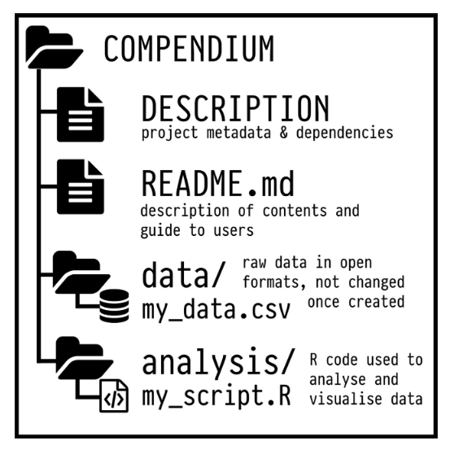
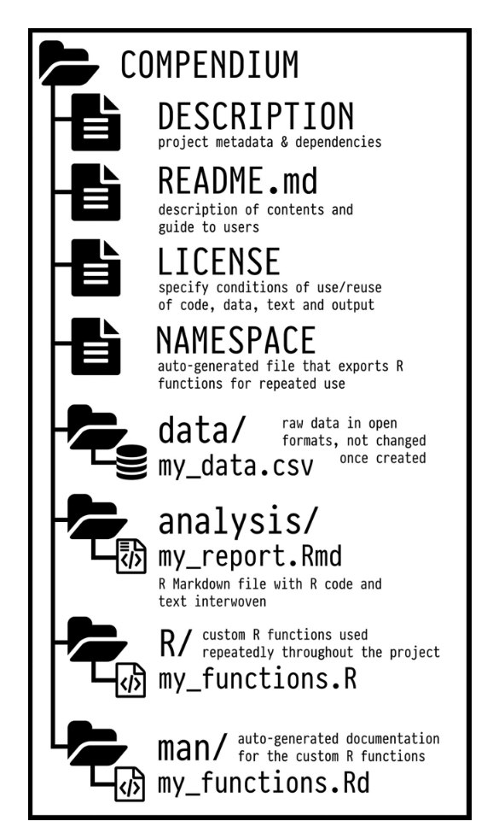
Marwick Compendium
Their structures range from very simple to more complex to accommodate projects of different complexity

Slide 28
How to organize your research files
Organize files for a project within a single computer directory
Design a system that is easy to use, easy to reuse, and easy to figure out
Use a standard system to organize your files

Slide 29
Advanced topics

Slide 30
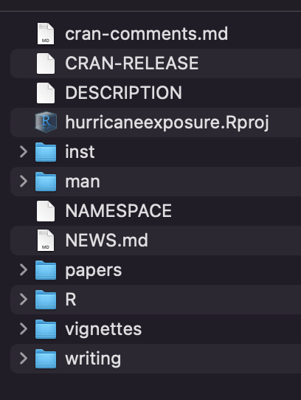
Coding to a standard directory structure
“ A research compendium should organize its files according to the prevailing conventions of the scholarly community, whether that be an academic discipline or a lab group. Following these conventions will help other people recognize the structure of the project, and also support tool building which takes advantage of the shared structure.” –Marwick et al., 2018

Slide 31
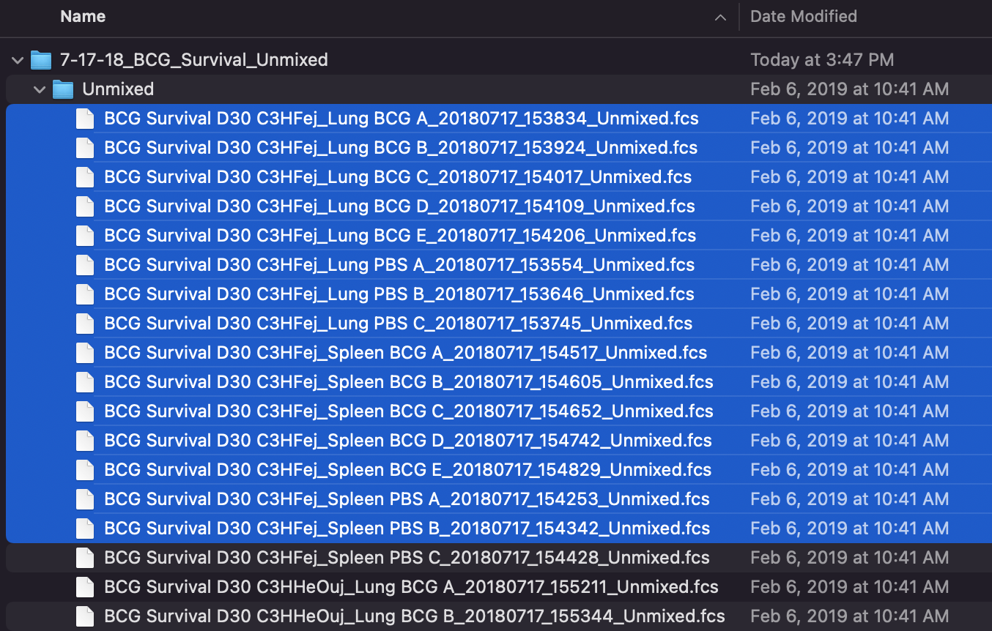
Coding to a standard directory structure
“Organizing data files into a single directory with consistent filenames prepares us to iterate over all of our data…
Think of it this way: remember when you discovered you could select many files with your mouse cursor? With this trick, you could move 60 files as easily as six files… By using consistent file naming and directory organization, you can do the same programmatically suing the Unix shell and other programming languages.” –Buffalo, 2015

Slide 32
Regular expressions and filenames
R can list all files in a directory with a system call
Map-apply programming lets you do the same thing to a list of files
Regular expressions help you pull information out of character strings, including filepaths

Slide 36
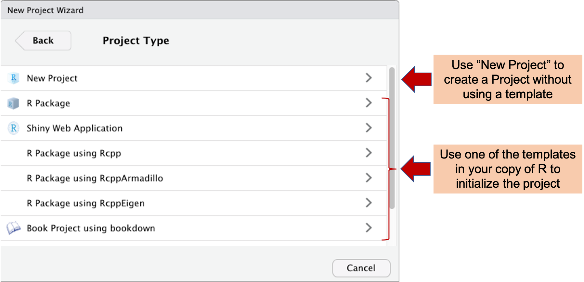
Creating an R Project template
R Project templates create more customized R projects. When you begin a new project with one, it will self-populate with a directory structure and potentially template files.
You get new templates by installing R packages.

Slide 37
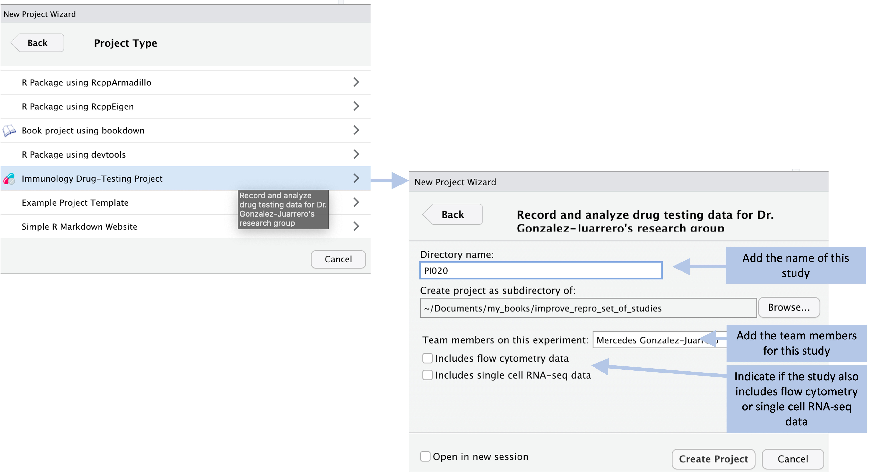
Creating an R Project template

Slide 38
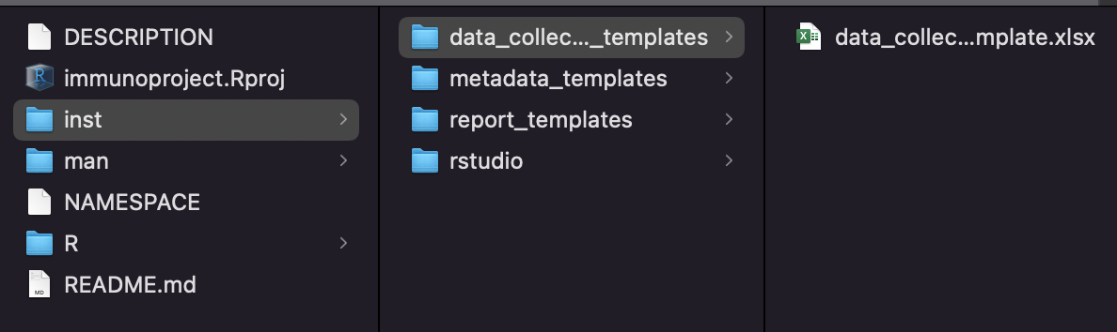
Creating an R Project template
You create an R Project template as an R package, which means it can be shared and loaded in the same way as other R packages
Most template files will be saved in the “inst” directory
You can use code in the R directory to set up the project directory structure and copy in template files
You can also use code in the R directory to customize the project set-up based on selections the user makes in the R Project Wizard

Slide 39
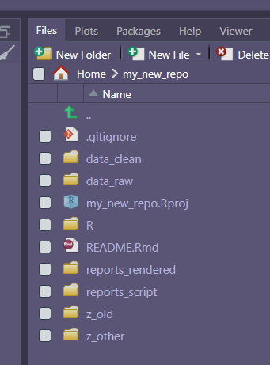
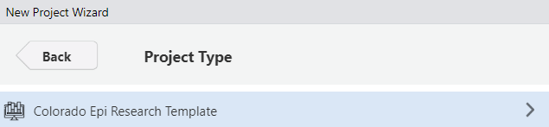
Creating an R Project template
ColoradoEpiResearch and ColoradoEpiApp are two examples of custom R project templates.
You can check out the code and make adjustments, or install and use as-is:
devtools::install_github("ColoradoEpiProject/ColoradoEpiResearch")

Slide 40

Git
Git is a version control system.
Git manages the evolution of a set of files (a repository) in a sane, highly structured way.
Git is like the “Track Features” features from Microsoft Word on steroids.
Git’s original purpose was to help groups of developers work collaboratively on big software projects. The data science community has re-purposed Git to use it to work on all of the different types of files that make up a typical project (data, figures, reports) in addition to source code.
Source: happygitwithr.com

Slide 41
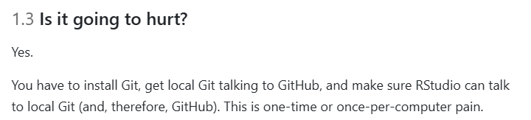
Should I Git…?
The initial installation process and change in workflow is all worth it for the benefit of version control and ease of communicating and collaborating with other people.
Source: happygitwithr.com

Slide 42
Benefits of Git
Exposure: if someone needs to see your work or if you want people to try out your code, they can clone or fork your repository with Git, or browse your project on GitHub.
You can track the development of projects (like R packages) on GitHub. You can modify your fork to add features or fix bugs and send them back to the owner as a proposed change.
If you need to collaborate on analysis or code development… use Git and GitHub! This is more analogous to Google Docs than it is to the edit, save, attach workflow.
Source: happygitwithr.com

Slide 43
Git Basics
Once you have successfully installed Git on your computer, for each individual project:
Dedicate a folder to it.
Make it an RStudio Project.
Make it a Git repository.
Repository: a directory of files that Git manages holistically.
Commit: functions like a snapshot of all the files in the repository at a specific moment.
Diff: a set of differences between two commits.
Source: happygitwithr.com

Slide 44
Git Basics
In your normal workflow, instead of only saving individual files, periodically you make a commit, which snapshots all of the files in the project. You can inspect that snapshot or revert to it later.
Every time you make a commit, you must also write a commit message. Messages should convey the why behind a change. The ‘diff’ will show the content of a change.
The history includes commit messages and diffs.
Git automatically assigns each commit with a unique identifying name (a Secure Hash Algorithm, or SHA), which is a string of 40 letters and numbers. You can use a commit’s SHA to revert to that commit.
Source: happygitwithr.com

Slide 45
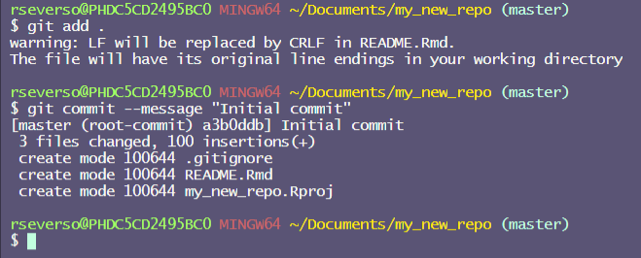
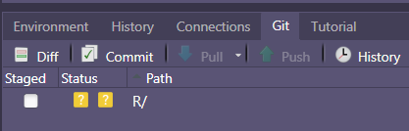
Git Basics
You can work with Git from the command line.
RStudio’s GUI has a “Git” pane:
Source: happygitwithr.com

Slide 46
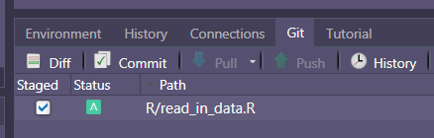
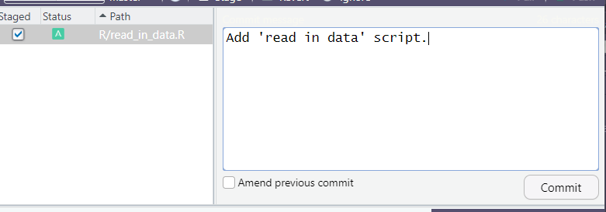
Git Basics
With RStudio’s GUI,
Files are automatically tracked.
You can stage a file, and
Commit with a commit message.
You can also see a log of your commits, and
Revert to previous commits.
Source: happygitwithr.com

Slide 47
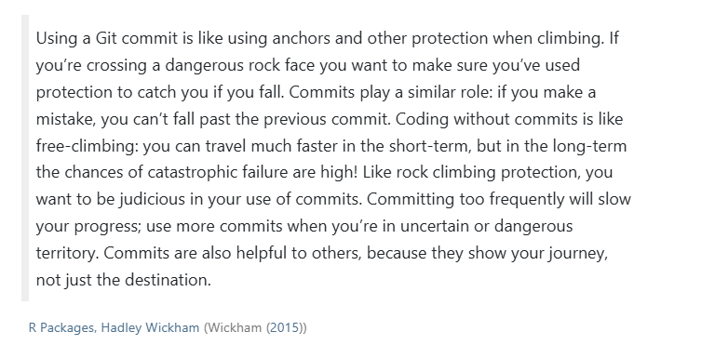
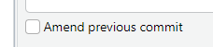
Git Basics
As you are making progress in a project, you might end up with a lot of small commits, especially when you are in “uncertain or dangerous territory.”
An option down the road can be to use a “Repeated Amend” workflow – instead of cluttering up your history with tiny commits, you build up a “good” commit gradually, by amending.
Source: happygitwithr.com

Slide 48

Git and GitHub
GitHub is one example of a hosting service that provides a home for your Git-based projects on the internet.
GitHub is hyperlink-rich, and allows you to visualize your repository and its history. Exploring your repository’s history is more convenient and safer (remote and read-only) in GitHub compared to the corresponding local Git workflow.
GitHub and is a nice way to collaborate if you want other people to be able to see your repository and to make changes.
Source: happygitwithr.com

Slide 49
Further resources
Marwick, B., Boettiger, C., and Mullen, L. (2018). Packaging data analytical work reproducibly using R (and friends). The American Statistician, 72(1):80–88.
Savage, A. (2020). Every Tool’s a Hammer: Life Is What You Make It. Atria Books.
Making R Project templates: https://rstudio.github.io/rstudio-extensions/rstudio_project_templates.html
Jenny Bryan’s Happy Git and Github for the user: https://happygitwithr.com/

Slide 50
Git Basics: Going back to the past
There are a few ways to “undo” and go back in time with Git.
There are two main scenarios that might come up:
You have not committed problematic code
You have committed problematic code
Source: happygitwithr.com

Slide 51
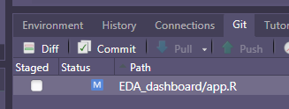
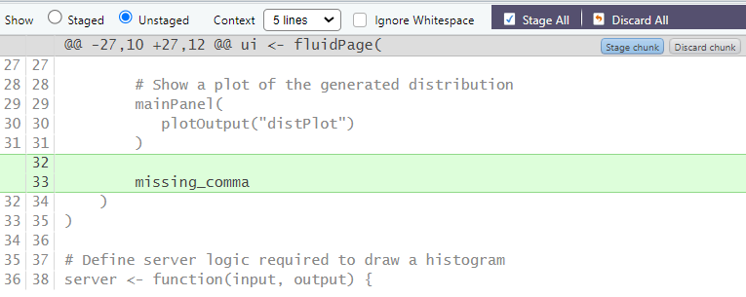
Git Basics: Going back to the past
If you have not committed problematic code, you can click the ‘Diff’ or ‘Commit’ buttons in the Git tab:
From there, you can discard individual chunks, or choose to “Discard all” of the changes that you’ve made since your last commit.
Source: happygitwithr.com

Slide 52
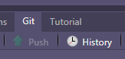
Git Basics: Going back to the past
If you have committed some problematic code, you can use your commit SHAs to revert to a previous commit.
To see your commit history, you can click the ‘History’ button in the Git tab:
Source: happygitwithr.com

Slide 53
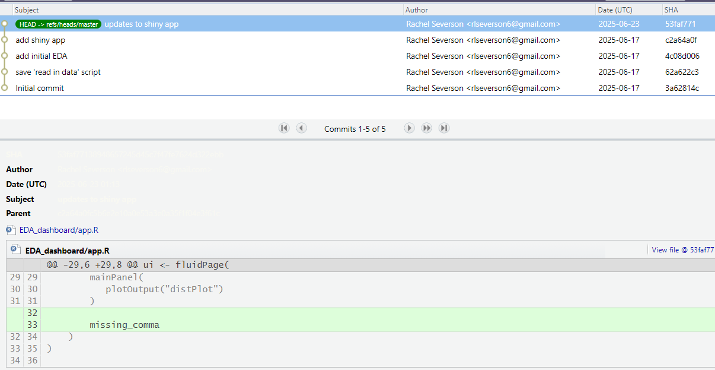
In the upper right corner, you can see the SHAs for all of your commits in this repo. 53faf771 is my problematic commit that is breaking my Shiny App. c2a64a0f is the commit that I would like to revert to.

Slide 54
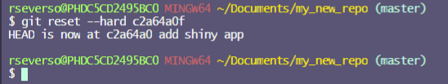
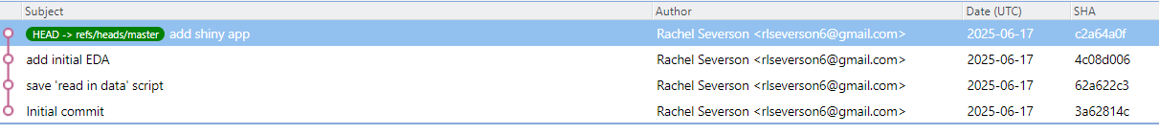
Git Basics: Going back to the past
In the Terminal pane, you can use the git reset --hard [SHA] command to return your repository to its state as of your selected commit.
After running git reset --hard, your selected commit is the most recent shown in the history, and your repo is reverted to its state as of that commit:

Slide 55
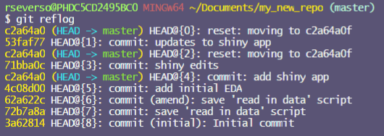
Git Basics: Going back to the past
You can go back to your original “bad” commit by using that commit’s SHA. To see all of your git actions, you can run git reflog:
This log shows the 53faf77 “updates to shiny app” commit. You can run git reset --hard 53faf77 to go back to that commit state.

